Slide 1
Nutritional Management of Acute Pancreatitis, in Patient with Active Alcohol Abuse
Margery Swan, Dietetic Intern U of MD College Park
Clinical Case Study at MedStar Harbor Hospital

Slide 2
Presentation Outline
General Patient Information
Medical History
Social History
Hospital Diagnosis
Course of Hospitalization
Laboratory Results
Pertinent Medications
Nutrition Interventions
Initial Assessment
Follow-Up Visit
Case Discussion
Medical Pathophysiology of Pancreatitis
Recommended Nutrition Interventions in Acute Pancreatitis
Case Update

Slide 3
Patient Information
56 YOWM
Presented with abdominal pain & nausea after binge drinking episode
Physical Examination:
Tender epigastric area and pain in RUQ (pain 8-10/10)
Hepatomegaly w/o rebound tenderness or rigidity
Alert & oriented X 3
Hospitalized from 4/14/13 – 4/17/13 at Medstar Harbor Hospital
In ED (emergency dept) diagnosed with Acute Pancreatitis
Physician's Initial Impression:
Pancreatitis – most likely alcohol induced
Hepatitis 2/2 alcohol abuse

Slide 4
Medical History
PMH Includes:
Hepatic:
Hepatitis C
Cirrhosis
Thrombocytopenia
History of liver failure
Cardiac
Coronary artery disease
Addiction
Nicotine
Reports smoking 1 pack per day Xs 40 years
Alcohol Abuse
Consumes 1 pint/day of liquor Xs 13 years
No Known Allergies

Slide 5
Social History
Lives with 3-4 roommates in Baltimore, MD
Unemployed, receiving disability
Limited financial & transportation resources

Slide 6
Medical Diagnosis
Acute Pancreatitis
Diagnostic Criteria¹
2 out of 3 features:
Abdominal pain characteristic of acute pancreatitis
Serum lipase/amylase 3X’s the upper limit of normal
Characteristics of acute pancreatitis on CT scan
Abdominal Sonogram
Echogenic prominent pancreas
Gallstones & gallbladder sludge
Moderate hepatomegaly
Mild – Moderate splenomegaly
Small amount of upper abdominal ascites

Slide 7
Hospital Course
Initial Plan:
IV fluids
NaCl 0.9% IV
Pain Management
2mg Morphine IV
Percocet 5mg q 6 hours
Replete Electrolytes and Nutrients
Mg Sulfate with 5% dextrose in H₂O
KCl given daily
4mg Folic Acid
100mg Thiamine
To prevent Wernicke's encephalopathy & Korsakoff syndrome
Multivitamin daily
Manage Withdrawal Symptoms
Chlordiazepoxide, Trazodone, Temormin
Valium & Xanax for agitation/anxiety
Notes:
Wernicke’s = brain damage in thalamus/hypothalamus
Korsakoff psychosis = damage memory

Slide 8
Laboratory Results
Hematology
Low platelets & high prothrombin time = ↑ risk for internal bleeding
76% patients with chronic liver disease develop²
Electrolyte Status
Hypokalemia, Hypomagnesium
Hepatology
Elevated Alk Phos, AST, ALT & Ammonia
Lipase initially 884U/L
Normal range: 0-160U/L

Slide 9
Medications
Cardiovascular:
Lovenox, Imdur, Aspirin, Lipitor, Norvasc
Pain Management:
Morphine & Percocet
Addiction Management:
Nicotine Patch, Trazodone, Tenormin
Valium & Xanax
Gastrointestinal Tract
Senokot, Lactulose, Protonix, Zofran (PRN)
Electrolyte Abnormalities:
Magnesium sulfate w/ 5% dextrose in H₂O → Magnesium Oxide
KCl Extended Release
MVI with Minerals
Prevent Further Deficiencies:
Thiamine & Folic Acid Supplementation

Slide 10
Nutrition Intervention (Initial Visit)
RN Consult for >15# wt loss
Diet: Clear Liquids
Appetite: Decreased appetite d/t abd pain
Diet History:
2 meals/day usually sandwich or pizza at local gas station
GI: Nausea – on Zofran
Skin: No pressure ulcers
Weight Trends:
BMI: 24kg/m²
Weight Trends
2/27/13 | 4/14/13 | UBW
178# | 180# | 185#

Slide 11
Estimated Needs
Source | Kcal Requirements | Protein Requirements | Fluid Requirements
Facility Standards | 25 – 30kcal/kg 2,043– 2,451kcals | 1.2 – 1.5g/kg 98 – 123g Protein | 25 – 30mL/kg 2,043mL– 2,451mL
EAL | No recommendation as of yet | No recommendation as of yet | No recommendation as of yet
Online Nutrition Care Manual | 25 -35kcal/kg | 1.2 – 1.5g/kg | 30mL/kg

Slide 12
Diagnosis: Inadequate oral intake related to decreased appetite, nausea and current diet as evidenced by pt reports decreased intake and nausea, clear liquid diet order (↓ in Kcals/Prot)

Slide 13
Nutrition Goals
Prevent weight loss
Patient will tolerate diet advancement
Eat >50% meals and supplements
Patient skin integrity will be maintained
Achieve normal electrolyte balance
Nutrition Interventions
Check weight weekly to trend
Monitor GI Function
Diet Recommendations: clear liquids → cardiac
Supplement Recommendations: Ensure Clear TID

Slide 14
Nutrition Follow-Up
Findings
Resolved nutrition diagnosis
Diet: Cardiac
Appetite: Improving, consuming 100% meals
GI: nausea d/t abd pain
Additional Interventions
Social work consult for assistance with resources
Supplement Recommendations: D/c Ensure Clears, order Ensure Plus with dinners
Provide diet education
Nutrition Therapy for Pancreatitis

Slide 15
Low-Fat Education

Slide 16
Case-Discussion:
Pancreatitis
Prevalence:
220,000 hospitalizations annually
17/100,000 new cases³
Currently increasing – potentially d/t obesity + type II DM⁴⁻⁵
Symptoms: tachycardia, fever, sweating, nausea, anorexia, epigastric pain radiating to the back
New Findings:
Chronic & acute alcoholic pancreatitis = same disease at different stages
Acinar cells in pancreas cells have ability to metabolize alcohol
May be genetic component
<10% alcohol abusers develop pancreatitis⁶

Slide 17
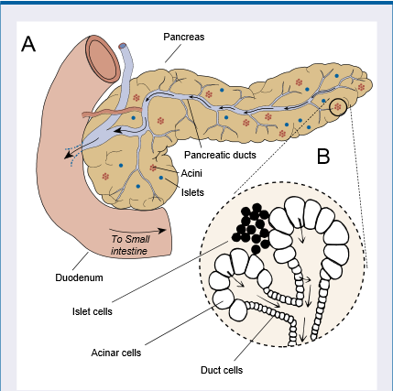
Case-Discussion Cont . . .
Acinar Cells
Enzyme Factories
Store inactive enzymes in vesicles
Majority of alcohol metabolized in pancreas via oxidative pathways
Picture taken from: NIAAA’s publication on Alcohol-Related Pancreatic Damage

Slide 18
Alcohol Damage & Metabolism
Picture taken from the NIAAA’s publication on: How is Alcohol Metabolized in the Body?
Possible Autodigestion
Ethanol
Metabolites
Acetaldehyde
By-Products
Reactive oxygen species (ROS)
Fatty acid ethyl esters (FAEEs)
Notes:
This may be the result of (1) the generation of ROS during oxidation of ethanol by CYP2E1 and (2) acetaldehyde-induced depletion of the ROS scavenger glutathione.

Slide 19
Prognosis & Treatment
Mild pancreatitis: low risk of complications (<6%)
Treatment involves: IV fluids, pain management, slow adv to low-fat diet
Severe pancreatitis (necrosis present): 19-30% mortality rate w/ average LOS = 30 days⁷
Treatment: IV fluids, pain management, pancreatic enzyme replacement, nutrition support, and rarely surgery

Slide 20
Nutrition Support⁷
Mild Pancreatitis: supportive care
If improving: clear liquid diet + adv as tolerated to low-fat
Severe/Not-Improving Mild Pancreatitis
Initiate enteral nutrition within 48-72 hours
Recommend enteral nutrition via nasojejunal feeds
Standard formula unless tube above ligament of treitz
Elemental, minimal fat
Semi-elemental w/ MCTs
Signs of intolerance: increase in fever, pain, GI symptoms, WBC
Parenteral ONLY if enteral not possible/not tolerating
Should NOT be initiated before 5 days

Slide 21
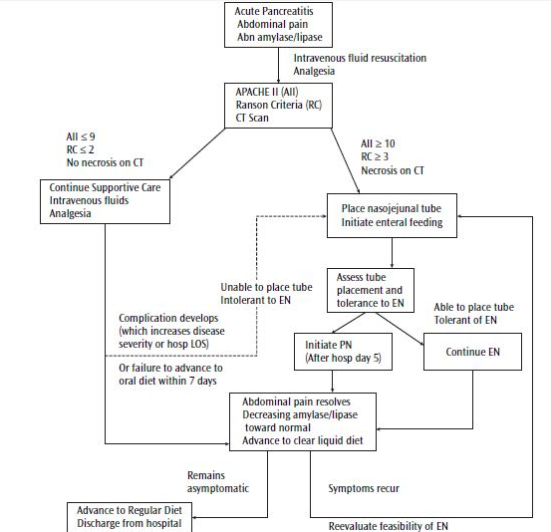
Chart taken from A.S.P.E. N. Nutrition Support Core Curriculum

Slide 22
Follow-Up
MD presented w/ abd pain + nausea after alcohol ingestion on 5/5/13
Estimated weight: 154#
Lipase: 867U/L

Slide 23
References
¹ Banks PA, Freeman ML. Practice guidelines in acute pancreatitis. Amer J of Gastroenterology. 2006; 101: 2379-2400.
² Afdhal N, McHutchison J, Brown R, Jacobson I, Manns M, Poordad F, Weksler B, Esteban R. Thrombocytopenia associated with chronic liver disease. Journal of hepatology. 2008;48(6):1000–7.
³ Stevens T, Conwell D. Disease management project: acute pancreatitis. Cleveland Clinic. 2011. Available at: http://www.clevelandclinicmeded.com/medicalpubs/diseasemanagement/gastroenterology/acute-pancreatitis/ Accessed June 9th, 2013.
⁴ Cheema N, Aldeen A. Focus on: Acute Pancreatitis. Amer College of Emergency Physicians’. 2010: Available at http://www.acep.org/Content.aspx?id=65139 Accessed June 9th, 2013
⁵ Noel RA, Braun DK, Patterson RE, Bloomgren GL. Increased risk of acute pancreatitis and biliary disease observed in patients with type 2 diabetes: a retrospective cohort study. Diabetes care. 2009;32(5):834–8
⁶Vonlaufen A, Wilson JS, Pirola RC, Apte MV. Role of alcohol metabolism in chronic pancreatitis. National Institute on Alcohol Abuse and Alcoholism. 2007. Available at http://pubs.niaaa.nih.gov/publications/arh301/48-54.htm Accessed June 8th, 2013
⁷Gottschlich MM, DeLeggee MH, Mattox T, Mueller C, Worthington P, Guenter P. The A.S.P.E.N. Nutrition Support Core Curriculum. Silver Spring, MD: American Society for Parenteral and Enteral Nutrition; 2007.

